Slide 1
STRUCTURE OF SCIENTIFIC DOCUMENTS
STW EX20003
UNIT 04
EXPERIMENTS

Slide 2
DETAILS OF EXPERIMENT
Experimental setup
Specifications of machines, materials, and instruments
Response variables, Control variables, Nuisance variables
Factor levels
Type of design and reason for its choice
Blocking and replicates
Procedure of conducting experiments
Safety procedures
Ethical considerations
Duration
Any special feature

Slide 3
MATERIALS
Give technical specifications, quantities, and source (or method of preparation)
Give brand name and manufacture and even distributor’s name, if material is non-standard one, not readily available in market
In case of specially procured or proprietary materials, give pertinent physical and chemical properties (rather than trade name)
If subjects are used, give total number of subjects, how they were selected, details of sex, age, profession, etc.

Slide 4
METHODS
Cite reference for methods
If techniques are widely familiar, use only their names, and give references if necessary
Any modification to technique should be explained, unless modification is trivial
Give details of unusual experimental designs or statistical methods

Slide 5
BASIC PRINCIPLES OF EXPERIMENTATION
Randomization: Random number properties –
uniform distribution,
(0, 1),
no correlation
Multiplicative congruential technique
Replication: to find extent of data variation
Blocking: effect of known nuisance variable

Slide 6
BASIC PRINCIPLES OF EXPERIMENTATION
Current (A)
10 A
12 A
15 A
Torque (N m)
 | I | II | III
10 12 15 | 500 550 | 510 540 | 485 560

Slide 7
ANALYSIS OF RESULTS
Most popular forms of data analysis:
Graphical presentation
Tabular presentation
Descriptive statistical analysis of data
Tests of hypotheses
Analysis of variance
Response Surface Methodology
Regression analysis

Slide 8
Tensile Strength, kg/cm²
30
20
10
0
10
15
20
25
30
35
40
Cotton Weight Percentage
GRAPHICAL PRESENTATION
Box Plots of Tensile Strength Versus Cotton Weight Percentage
Tensile Strength, kg/cm²
30
20
10
0
10
15
20
25
30
35
40
Cotton Weight Percentage
Scatter Diagram of Tensile Strength Versus Cotton Weight Percentage

Slide 9
JOINING ADJACENT DATA POINTS IS NOT CORRECT
50
40
30
20
10
●
●
●
Mean Value of MRR (g/s)
●
●
●
●
●
10 15 20 25 30 35 40 45
Speed (m/s)
MEAN MATERIAL REMOVAL RATE VS. SPEED

Slide 10
50
40
30
20
10
●
●
●
●
Mean and Its 95 % C.I.
Mean Value of MRR (g/s)
●
●
●
●
●
10 15 20 25 30 35 40 45
Speed (m/s)
Mean Material Removal Rate vs. Speed

Slide 11
50
40
30
20
10
●
●
●
Mean Value of MRR (g/s)
●
●
●
●
●
10 15 20 25 30 35 40 45
Speed (m/s)
High-Precision Measurement

Slide 12
WRITING GUIDELINES
Use passive voice to describe experiments
Do not switch between active voice and passive too much
We measured the tensile strength. It was measured by using a universal testing machine. (Incorrect)
We measured the tensile strength with the use of a universal testing machine. (Correct)
Use past tense to report past actions
Use present tense to indicate listing of criteria in a table, etc.

Slide 13
ERROR BARS
Error bars must be stated clearly
Error bars represent one standard deviation, one standard error, or 95% confidence interval
For human studies and animal studies, one has to follow national and international guidelines (such as Declaration of Helsinki) for conducting experiments on them
ETHICAL CONDUCT

Slide 14
DESCRIPTIVE STATISTICAL ANALYSIS
Frequency Distribution
Central Tendency: Mean, Mode, and Median
Dispersion around Central Tendency: Standard Deviation and Range
Skewness
Kurtosis
Note:
For small sample size and for categorical variables, median is better
Standard deviation = √ {[1/(n – 1)]∑(x_{i} –x_{avg})²}

Slide 15
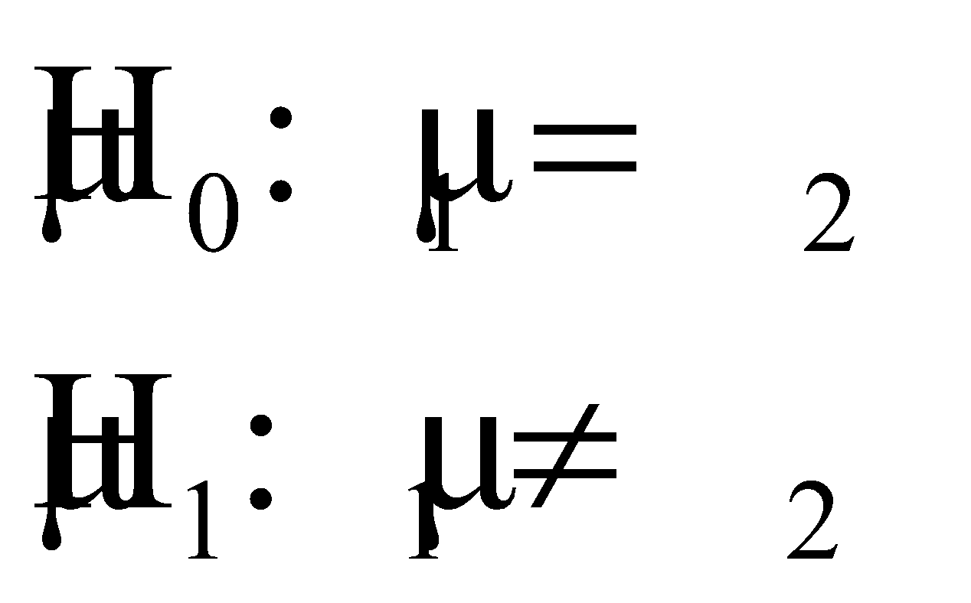
TEST OF HYPOTHESIS
Equality of Means or Equality of Variances is common
Mention null and alternative hypotheses:
Note: It is subscript zero (not alphabet ‘o’) for null hypothesis
Mention test statistic used (z, t, χ², F) along with degrees of freedom (if appropriate)
Decision could be:
Reject H₀
Cannot reject H₀
Accept H₁
Cannot accept H₁
Never say ‘Accept H₀’
Mention level of significance and/ or p-value

Slide 16
ANOVA Table
Single-Factor, Fixed Effects Model
Source of Variation | Sum of Squares | Degrees of Freedom | Mean Square | F₀
Between treatments | SS_{Tr} | a – 1 | MS_{Tr} | MS_{Tr}/MS_{E}
Error (within treatments) | SS_{E} = SS_{T} – SS_{Tr} | N – a | MS_{E}
Total | SS_{T} | N – 1

Slide 17
REGRESSION ANALYSIS
Regression equation
R-square and Adjusted R-square
Significance of regression parameters
(standard errors or t-statistics of parameters)
Significance of model (F-statistic)
Viscosity = 1 566 + 7.62 Temp + 8.58 Feed Rate
Std. Error: (61.6) (0.618) (2.439)
t: (25.43) (12.32) (3.52)
R² = 92.7% Adj. R² = 91.6% F = 82.50
R²: Coefficient of Multiple Determination

Slide 18
EXAMPLES
•
•
•
•
•
•
•
R² = 0.9701
•
R² = 0.30
Too few number of points
Too few number of points
High dispersion of values

Slide 19
EXPLANATION OF DATA AND RESULTS
Explanation of data and results is a scientific necessity
Researcher must give acceptable explanation of variation of experimental data within and between experiments
Quantitative explanation requires mathematical and/ or statistical modeling
Qualitative explanation is logical reasoning of cause-effect relationships among variables

Slide 20
VALIDATION OF EXPERIMENTAL RESULTS
INTERNAL VALIDATION
EXTERNAL VALIDATION
Checks for inconsistency or contradiction in data and results
Presence of inconsistency or contradiction indicates that experiment had not been carried out in scientific and well-planned manner
Checks for matching of results with those obtained by others
In case of mismatch, credible explanation must be given
If researcher’s test conditions are different from those of other researchers, results may not match, but they should be plausible and explainable

Slide 21
INTERPRETATION OF EXPERIMENTAL RESULTS
Theoretical interpretations bring out latent relationships among factors and prognosticate likely effect of changes in factor settings on figures of merit
Practical interpretations highlight possible ways results can be used in practice to develop new materials, products, or processes, find optimum factor settings, or achieve improvement in performance in existing process or product

Slide 22
GENERALIZATION OF EXPERIMENTAL RESULTS
Experiments are carried out in specific experimental setting
Results should be general enough to be of interest to other researchers in the field
Setting of objectives of experiment, choosing variables and their settings, using measurement system with high capability, and analyzing and interpreting results properly hold key to generalization

Slide 23
THANK YOU!

